Slide 1
Computer Memory

Slide 2
Memory
A memory is just like a human brain. It is used to store data and instructions. Computer memory is the storage space in the computer, where data is to be processed and instructions required for processing are stored. The memory is divided into large number of small parts called cells. Each location or cell has a unique address, which varies from zero to memory size minus one. For example, if the computer has 64k words, then this memory unit has 64 * 1024 = 65536 memory locations. The address of these locations varies from 0 to 65535.

Slide 3
Types of Memory
Memory is primarily of three types −
Cache Memory
Primary Memory/Main Memory
Secondary Memory

Slide 4
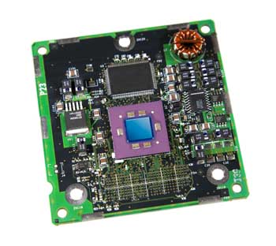
Cache Memory
Cache memory is a very high speed semiconductor memory which can speed up the CPU. It acts as a buffer between the CPU and the main memory. It is used to hold those parts of data and program which are most frequently used by the CPU. The parts of data and programs are transferred from the disk to cache memory by the operating system, from where the CPU can access them.

Slide 5
Advantages and Disadvantage of Cache Memory
Advantages
The advantages of cache memory are as follows −
Cache memory is faster than main memory.
It consumes less access time as compared to main memory.
It stores the program that can be executed within a short period of time.
It stores data for temporary use.
Disadvantages
The disadvantages of cache memory are as follows −
Cache memory has limited capacity.
It is very expensive.

Slide 6
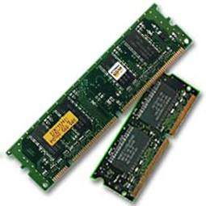
Primary Memory
Primary memory holds only those data and instructions on which the computer is currently working. It has a limited capacity and data is lost when power is switched off. It is generally made up of semiconductor device. These memories are not as fast as registers. The data and instruction required to be processed resides in the main memory. It is divided into two subcategories RAM and ROM.

Slide 7
Characteristics of Main Memory
These are semiconductor memories.
It is known as the main memory.
Usually volatile memory.
Data is lost in case power is switched off.
It is the working memory of the computer.
Faster than secondary memories.
A computer cannot run without the primary memory.

Slide 8
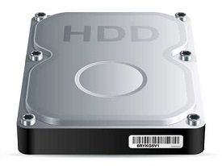
Secondary Memory
This type of memory is also known as external memory or non-volatile. It is slower than the main memory. These are used for storing data/information permanently. CPU directly does not access these memories, instead they are accessed via input-output routines. The contents of secondary memories are first transferred to the main memory, and then the CPU can access it. For example, disk, CD-ROM, DVD, etc.

Slide 9
Characteristics of Secondary Memory
These are magnetic and optical memories.
It is known as the backup memory.
It is a non-volatile memory.
Data is permanently stored even if power is switched off.
It is used for storage of data in a computer.
Computer may run without the secondary memory.
Slower than primary memories.

Slide 10
RAM
RAM (Random Access Memory) is the internal memory of the CPU for storing data, program, and program result. It is a read/write memory which stores data until the machine is working. As soon as the machine is switched off, data is erased
Access time in RAM is independent of the address, that is, each storage location inside the memory is as easy to reach as other locations and takes the same amount of time. Data in the RAM can be accessed randomly but it is very expensive.
RAM is volatile, i.e. data stored in it is lost when we switch off the computer or if there is a power failure. Hence, a backup Uninterruptible Power System (UPS) is often used with computers. RAM is small, both in terms of its physical size and in the amount of data it can hold.

Slide 11
Types RAM
RAM is of two types −
Static RAM (SRAM)
Dynamic RAM (DRAM)

Slide 12
Static RAM (SRAM)
The word static indicates that the memory retains its contents as long as power is being supplied. However, data is lost when the power gets down due to volatile nature. SRAM chips use a matrix of 6-transistors and no capacitors. Transistors do not require power to prevent leakage, so SRAM need not be refreshed on a regular basis.
There is extra space in the matrix, hence SRAM uses more chips than DRAM for the same amount of storage space, making the manufacturing costs higher. SRAM is thus used as cache memory and has very fast access.
Characteristic of Static RAM
Long life
No need to refresh
Faster
Used as cache memory
Large size
Expensive
High power consumption

Slide 13
Dynamic RAM (DRAM)
DRAM, unlike SRAM, must be continually refreshed in order to maintain the data. This is done by placing the memory on a refresh circuit that rewrites the data several hundred times per second. DRAM is used for most system memory as it is cheap and small. All DRAMs are made up of memory cells, which are composed of one capacitor and one transistor.
Characteristics of Dynamic RAM
Short data lifetime
Needs to be refreshed continuously
Slower as compared to SRAM
Used as RAM
Smaller in size
Less expensive
Less power consumption

Slide 14
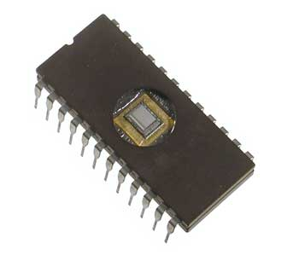
ROM
ROM stands for Read Only Memory. The memory from which we can only read but cannot write on it. This type of memory is non-volatile. The information is stored permanently in such memories during manufacture. A ROM stores such instructions that are required to start a computer. This operation is referred to as bootstrap. ROM chips are not only used in the computer but also in other electronic items like washing machine and microwave oven.

Slide 15
Types of ROM
MROM (Masked ROM)
The very first ROMs were hard-wired devices that contained a pre-programmed set of data or instructions. These kind of ROMs are known as masked ROMs, which are inexpensive.
PROM (Programmable Read Only Memory)
PROM is read-only memory that can be modified only once by a user. The user buys a blank PROM and enters the desired contents using a PROM program. Inside the PROM chip, there are small fuses which are burnt open during programming. It can be programmed only once and is not erasable.
EPROM (Erasable and Programmable Read Only Memory)
EPROM can be erased by exposing it to ultra-violet light for a duration of up to 40 minutes. Usually, an EPROM eraser achieves this function. During programming, an electrical charge is trapped in an insulated gate region. The charge is retained for more than 10 years because the charge has no leakage path. For erasing this charge, ultra-violet light is passed through a quartz crystal window (lid). This exposure to ultra-violet light dissipates the charge. During normal use, the quartz lid is sealed with a sticker.

Slide 16
Types of ROM
EEPROM (Electrically Erasable and Programmable Read Only Memory)
EEPROM is programmed and erased electrically. It can be erased and reprogrammed about ten thousand times. Both erasing and programming take about 4 to 10 ms (millisecond). In EEPROM, any location can be selectively erased and programmed. EEPROMs can be erased one byte at a time, rather than erasing the entire chip. Hence, the process of reprogramming is flexible but slow.

Slide 17
Advantages of ROM
The advantages of ROM are as follows −
Non-volatile in nature
Cannot be accidentally changed
Cheaper than RAMs
Easy to test
More reliable than RAMs
Static and do not require refreshing
Contents are always known and can be verified

Slide 18
Relationship between Hardware and Software
Hardware and software are mutually dependent on each other. Both of them must work together to make a computer produce a useful output.
Software cannot be utilized without supporting hardware.
Hardware without a set of programs to operate upon cannot be utilized and is useless.
To get a particular job done on the computer, relevant software should be loaded into the hardware.
Hardware is a one-time expense.
Software development is very expensive and is a continuing expense.
Different software applications can be loaded on a hardware to run different jobs.
A software acts as an interface between the user and the hardware.
If the hardware is the 'heart' of a computer system, then the software is its 'soul'. Both are complementary to each other.

Slide 19
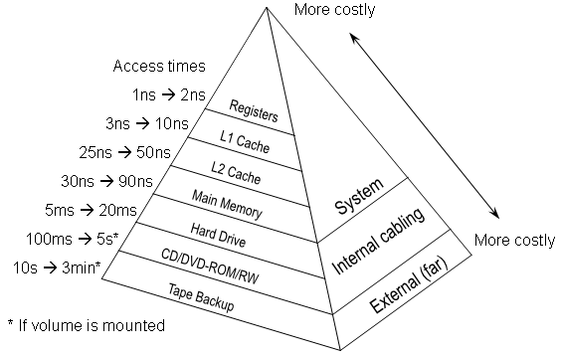
Memory Hierarch

